Slide 1



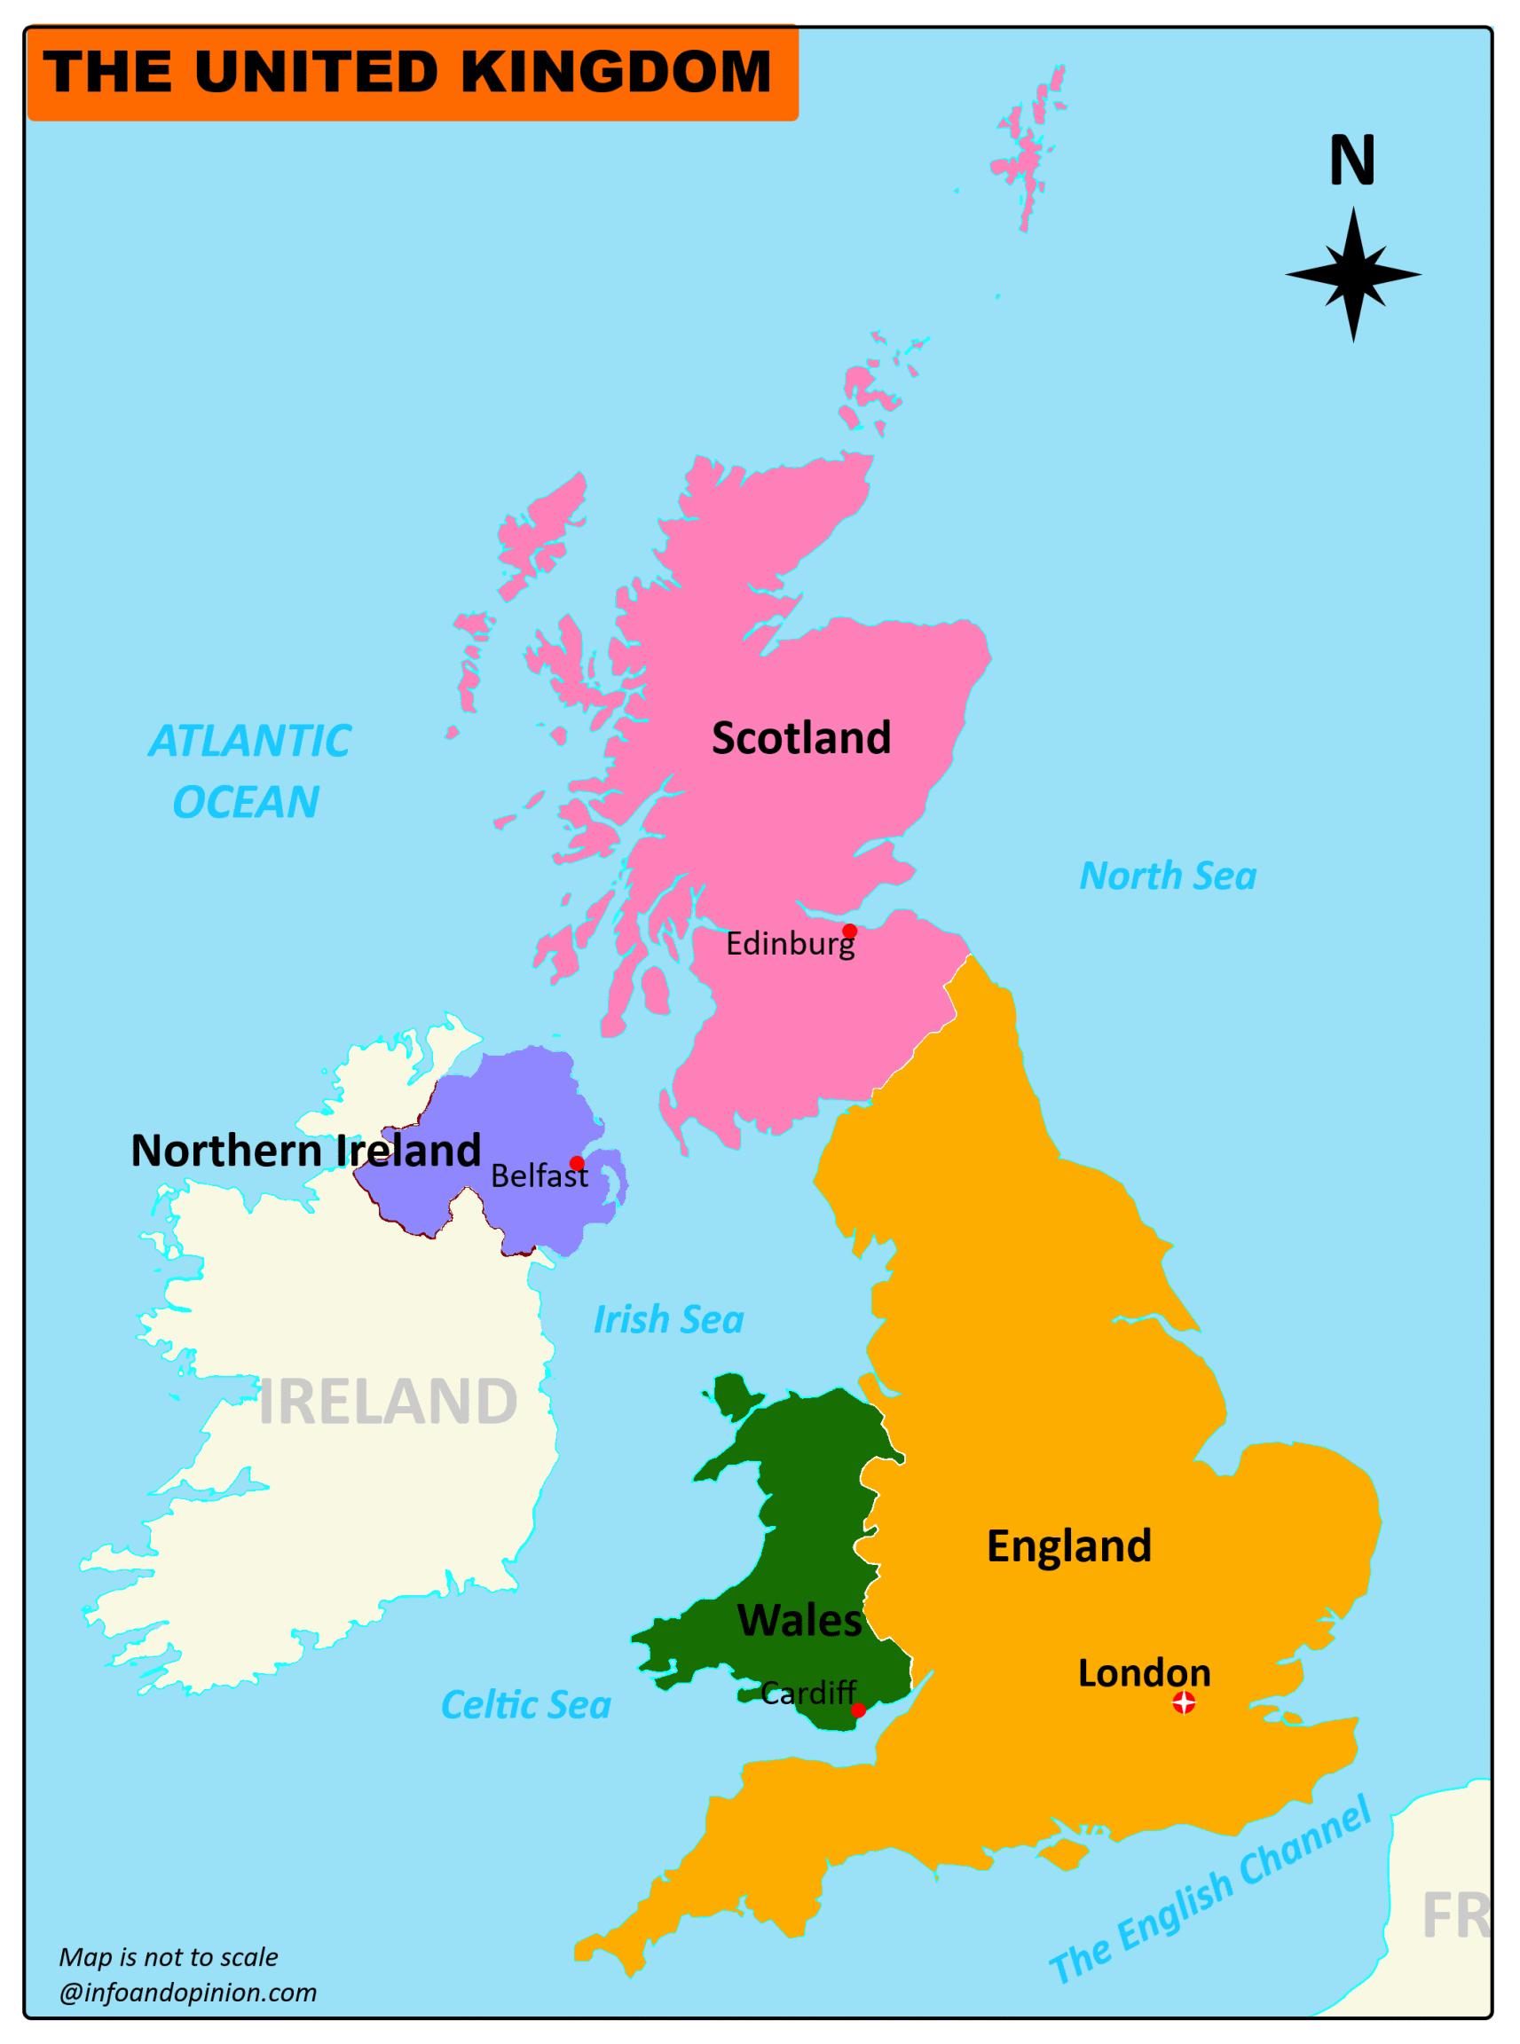

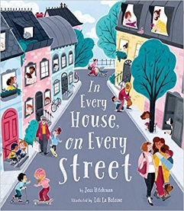
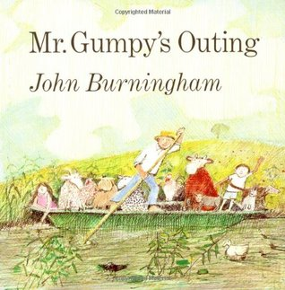

Understanding the World
This teaches us about the environments that we share with others, including their homes, school and places in the local community. We will learn that maps are 2-D representations of places and journeys. We will also learn that we live on planet Earth and The United Kingdom is made up of four countries: England, Northern Ireland, Scotland and Wales.
Physical Development
We will be learning to ….
develop our pencil grips and rehearse letter formations.
develop our scissor control.
begin to develop balance and control.
make shapes with our bodies.
Expressive Arts and Design
This half term we will be …….
Creating collaboratively, sharing
ideas and use a variety of resources to
make products inspired by existing
products, stories or their own ideas, interests or experiences.
Constructing simple structures and models using a range of materials.
Selecting appropriate tools and media to draw with.
What is marvellous about me?
Personal, Social and Emotional
Development
PSHE unit:- Me and my Relationships
This unit supports children to develop 4 key skills
of empathy, self awareness, social skills and self
motivation. It supports them to explore what it
means to be me as well as support social skills
needed to develop friendships and relationships.
Communication and Language
This half term we will be…..
Developing storylines in their pretend play and use talk to help work out problems and organise thinking and activities.
Asking questions to find out more and understand what has been said to them.
Listening carefully in a range of situations and is aware of the importance of listening
Literacy- Reading and Writing
In phonics we will be learning the sounds in set 1 of Read, Write Inc. These include the single letter sounds. We will be learning how to identify these sounds in words as well as blending and segmenting these sounds into simple CVC words. We will focus on how to hold our pencil using the correct tripod grip and write our letters using pre-cursive formations.
Mathematics
In Maths we will be learning to subitise to at least 3 within larger amounts. We will be counting with 1:1 correspondence, exploring how numbers are composed of ones and exploring the composition of the numbers 3 and 4. We will also be comparing quantities using ‘more than’ and ‘fewer than’.

Slide 2

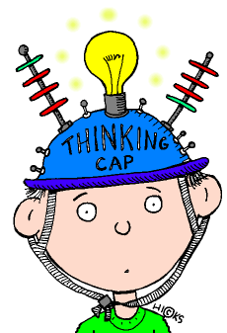



What is marvellous about me?
Key Vocabulary- Phonics
Blending- to pull together individual sounds or
syllables within words.
Segmenting- breaking words down into individual
sounds or syllables.
Phoneme- The smallest unit of sound. A sound a
letter makes.
Grapheme- a way of writing down a phoneme.
Home Learning Challenges
Select from the list below the activities that you would like to do as your home learning
challenges. You can present your challenges in any way. Have fun and be creative.
My Map
Think of a journey that you make regularly. Draw a map to show the route.
We are Family !
Create a family
portrait or family tree.
.
Key Vocabulary- Maths
Numeral- a symbol , 1, 2, 3 or a word one, two, three that stands for a number.
Subitising: The ability to instantly recognise the number of items in a set without counting them individually.
Animal Challenge
What can you find out
about the animal
your class is named after?
Celebrate yourself
What’s special about
you?
Bear Hunt
Take your family on a
‘bear hunt’ walk. Can you
Find the best hiding
Places for a bear?
Signs of Autumn
How many different
signs of Autumn can
you find?
Topic words:
School, Class, Acorn Centre, The Hermitage schools, teacher, phonics, Maths, creative, hall, office senses, smell, emotions, anger, happiness, sadness, fear, map, street, town, village, community, Earth, United Kingdom, journey, holiday, Building, site, safety, houses, homes, towers, shapes.
Supporting learning at home:
Daily reading
Sound sheets- rehearsing letter formation
http://www.bbc.co.uk/schools/scienceclips/ages/5_6/science_5_6.shtml
http://www.phonicsplay.co.uk/ Phase 2 – game “Obb and Bob”
Cbeebies- Number blocks & Alpha blocks
Please keep PE kits in school. They will be returned at the end of each half term for washing.

