Slide 1

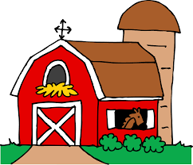
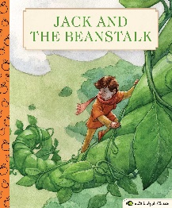
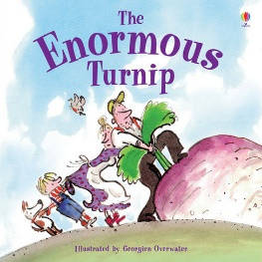

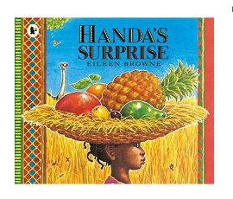
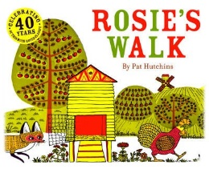

Understanding the World
This half term we will be…
Exploring what makes our world wonderful.
Investigating what plants need to grow
Beginning to identify the origins of food
Learning about the similarities and differences of animals and their young (including exploring life cycles)
Discovering how different groups of people celebrate Spring.
Physical Development
This half term we will be…
Working collaboratively to solve problems
Creating movement patterns
Confidently and safely using a range of large and small apparatus alone and in a group.
Expressive Arts and Design
This half term we will be …….
Exploring, building and playing
with a range of resources.
Using primary and other coloured paint and a range of methods of application.
Exploring artwork by famous artists and talk about our likes and dislikes.
Communicate our ideas as we are creating artwork.
How does your garden grow?
Personal, Social and Emotional Development
This half term we will be…
Talking about the things we like and don’t like doing.
Exploring the importance of good health
Recognising when we are feeling proud or exciting.
Learning how to stand up for our rights without hurting others.
Communication and Language
This half term we will be…..
Learning new vocabulary and social phrases
Asking relevant scientific questions to find out more
Listening to and talking about non-fiction books to develop a deep familiarity with new knowledge and vocabulary.
Literacy- Reading and Writing
This half term we will be…
Using our taught sounds to sound out and blend words quickly and accurately.
Talking about what we have read and giving opinions.
Retelling stories with increased detail
Using the sounds we have learned to write short captions.
Beginning to explore capital letters and full stops.
Mathematics- Numbers and Shape, Space and Measures
Counting, comparing, ordering, representing, partitioning and subitising numbers to 10.
Developing an understanding of sharing into equal groups
Investigating and comparing length, hight
Using money in role-play
Learning about 3D shapes
Odd and even numbers

Slide 2

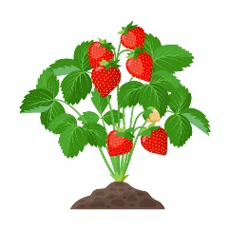
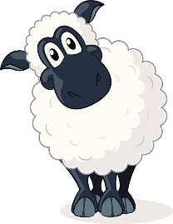
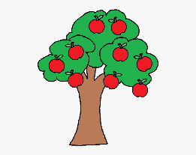
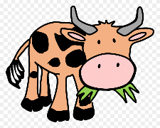
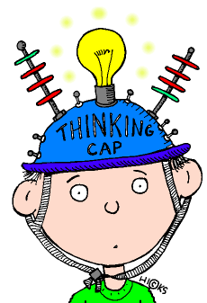



How does your garden grow?
Key Vocabulary- Phonics
Blending- to pull together individual sounds or
syllables within words.
Segmenting- breaking words down into individual
sounds or syllables.
Phoneme- The smallest unit of sound. A sound a
letter makes.
Grapheme- a way of writing down a phoneme.
Finger space, Capital letter, Full stop
Home Learning Challenges
Select from the list below the activities that you would like to do as your home learning
challenges. You can present your challenges in any way. Have fun and be creative.
Green Grow
Sow some fast growing seeds and keep a record of how they are growing.
Veggie Views
Draw your favourite fruit and vegetable. Which words can you use to describe it?
.
Key Vocabulary- Maths
Capacity, full, nearly full, half full, empty, nearly empty, number bonds, whole, part, share, equal amount, subitise, partition, count, more than, fewer than, greater than, less than.
Fridge Raider
Which fruits and vegetable can you find in your house?
Super Salad
Use different coloured fruits or vegetables to make a rainbow salad.
Old MacDonald
Imagine you are a farmer. What kinds of animals would you keep and which crops will you grow?
Farm Family Portrait
Draw and label some farmyard animals and their babies.
Topic words:
seed, soil, root, leaves, stalk, grow, water, sunlight, healthy, unhealthy, diet, vitamin, vegetable, fruit, hydrate, sugar, fat, exercise, heart, baby, calf, kid, chick, lamb, piglet, cygnet, puppy, kitten, produce.
Supporting learning at home:
Daily reading
Sound sheets- rehearsing letter formation
http://www.bbc.co.uk/schools/scienceclips/ages/5_6/science_5_6.shtml
http://www.phonicsplay.co.uk/ Phase 2 – game “Obb and Bob”
Cbeebies- Number blocks & Alpha blocks
Seesaw phonics videos
Please keep PE kits in school. They will be returned at the end of each half term for washing.

