Slide 1


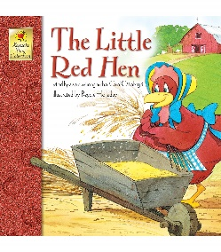

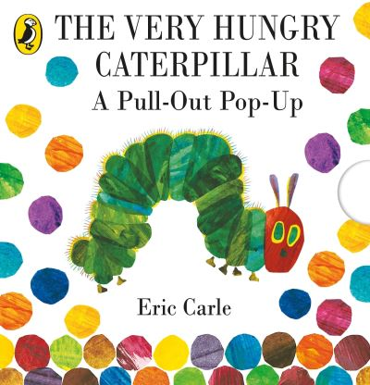
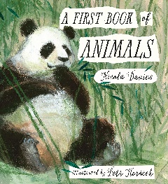

Understanding the World
This half term we will be…
Identifying common features for different groups of animals, including wild and domestic animals.
Describing how two places are the same or different using simple picture maps, photographs, data and other geographical resources.
Physical Development
This half term we will be…
Moving confidently in a range of ways.
developing the foundations of a handwriting style by using a tripod grip.
Expressive Arts and Design
This half term we will be …….
making simple prints using a variety of tools,
drawing or painting a place from observation or imagination.
exploring artwork by famous artists and talk about their likes and dislikes.
How are animals different?
Personal, Social and Emotional Development
This half term we will be…
Identifying when we (or others) are feeling sad or angry.
Talking about how we feel when we miss people and what we can do to feel better.
Identifying when things are fair or unfair and finding ways to make things fair.
Communication and Language
This half term we will be…..
Asking relevant scientific question to find out more, explaining how things work and why they might happen.
listening to and talk about selected non-fiction books to develop a deep familiarity with new knowledge and vocabulary.
Literacy- Reading and Writing
This half term we will be…
Talking about stories and making connections with events in our own lives or other familiar stories.
Beginning to write simple sentences with a capital letter and full stop.
Describing the characters, events and settings in stories that have been read to them using recently introduced vocabulary.
Mathematics- Numbers and Shape, Space and Measures
This half term we will be…
Exploring addition and subtraction with numbers to 10, using concrete objects, pictorial representations and number lines.
Matching, rotating and manipulating shapes
Composing and decomposing shapes
Automatically recalling (without reference to rhymes, counting or other aids) number bonds up to 5 (including subtraction facts) and some number bonds to 10, including double facts.

Slide 2



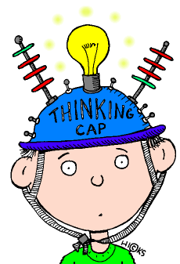



How animals are different?
Key Vocabulary- Phonics
Blending- to pull together individual sounds or
syllables within words.
Segmenting- breaking words down into individual
sounds or syllables.
Phoneme- The smallest unit of sound. A sound a
letter makes.
Grapheme- a way of writing down a phoneme.
Home Learning Challenges
Select from the list below the activities that you would like to do as your home learning
challenges. You can present your challenges in any way. Have fun and be creative.
Spotted on Safari
Draw a picture of your favourite safari animal. Which words can you use to describe it?
Safari at Home
Visit your garden or a park. Make a list of the animals you can spot.
.
Key Vocabulary- Maths
Addition, subtraction, number bonds, subitising, doubles, pattern, repeat, forwards, backwards, up, down, triangle, rectangle, square, circle, more, less, whole, part, greater than, fewer.
Model Animals
Using junk modelling, make your favourite safari animal. Which features do you need to remember?
Researching Reader
Use a book from home or visit a library. What new facts can you learn about animals?
Safari Small World
Using a tray/old box, collect natural objects from outside and make a safari landscape. Which animals might you add?
Banging Beats
Using pots and pans with wooden spoons, try banging your own beat. Can your family/friends join in?
Animal Safari topic words:
Safari, zoo, animals, pets, reptile, mammal, bird, eggs, scaly, mammal, bird, fur, feathers, beak, claws, teeth, carnivore, meat, herbivore, plants, omnivore, brave, resilient, Africa, Australia, lion, koala, endangered, extinct, conservation, camouflage, wildlife, rainforest, desert, polar, pattern, spot, stripe
Supporting learning at home:
Daily reading
Sound sheets- rehearsing letter formation
http://www.bbc.co.uk/schools/scienceclips/ages/5_6/science_5_6.shtml
http://www.phonicsplay.co.uk/
Cbeebies- Number blocks & Alpha blocks
Please keep PE kits in school. They will be returned at the end of each half term for washing.

