Slide 1

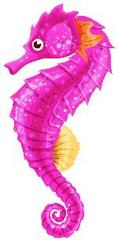

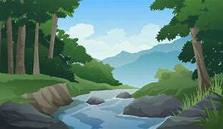

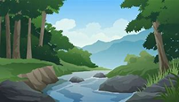

Understanding the World
This half term we will be…
Learning about the different animals that can be found at the seaside.
Using maps and globes to locate seas and oceans
Learning about UK landmarks and places around Woking that are fun to visit during the holidays
Looking at forests and cities as a holiday/day out destination.
Physical Development
This half term we will be…
Practising our multiskills and flat races in preparation for Sports Day
Ensuring we are forming letters following the handwriting policy.
Expressive Arts and Design
This half term we will be …….
Learning how to sing different
sea songs
Viewing and critiquing the work of different famous artists.
Create imaginative designs.
What is your favorite place to visit?
Personal, Social and Emotional Development
This half term we will be…
Revisiting how to manage our own basic needs
Revisiting the reasons for rules and knowing right from wrong.
Revisit learning about our feelings.
Prepare for the changes to a new year group.
Communication and Language
This half term we will be…..
Giving focused attention, responding appropriately even when actively engaged in another task
Holding conversations with back and forth exchanges
Listening and responding with relevant questions and comments.
Literacy- Reading and Writing
This half term we will be…
Using our taught sounds to sound out and blend words quickly and accurately.
Self correcting when our reading does not make sense
Recognising more tricky words on sight and beginning to use these accurately in our writing.
Write simple sentences which are punctuated with capital letters and full stops.
Mathematics- Numbers and Shape, Space and Measures
This half term we will be…
Recapping our number bonds, doubles, halves, odds and even numbers.
Subitising quickly and accurately to 5.
Exploring shape and number patterns
Continuing to count beyond 20.

Slide 2
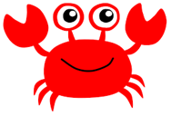




What is your favorite place to visit?
Topic words:
seashore, crab, hermit crab, shell, anemone, starfish, rock pool, seaweed, gull, cliff, limpet, barnacle, seal, herbivore, carnivore, omnivore, marine, sea, ocean, shark, whale, dolphin, squid, octopus, jellyfish, fish, scales, gills, tail, fin, sailor, pirate, map, treasure, boat, ship, galleon, compass, north, south, east, west, captain, crew, deck, rigging, crows nest, Jolly Roger, island, anchor, sail, oar, rudder, coastguard, life jacket, lifeboat, waterproof.
Home Learning Challenges
Select from the list below the activities that you would like to do as your home learning
challenges. You can present your challenges in any way. Have fun and be creative.
Treasure Chest
Make a treasure chest containing all your special objects from this year.
Under the Sea
Design your own sea animal. How do they move? What do they eat?
.
Wish you were here
Pretend you are at the seaside. Send a postcard to your friends.
Ready to Go
Pack your bag for the seaside. What do you need to remember?
Shipwreck
Use junk modelling to create a shipwreck. What can you use for the different parts?
Treasure Map
Draw a map of your garden. Where would you hide the treasure? X marks the spot!
Supporting learning at home:
Daily reading
Sound sheets- rehearsing letter formation
http://www.bbc.co.uk/schools/scienceclips/ages/5_6/science_5_6.shtml
http://www.phonicsplay.co.uk/ Phase 2 – game “Obb and Bob”
Cbeebies- Number blocks & Alpha blocks
Please keep PE kits in school. They will be returned at the end of each half term for washing.

