Slide 1

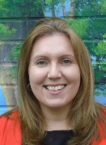
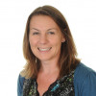
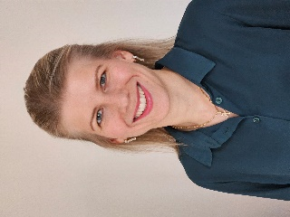
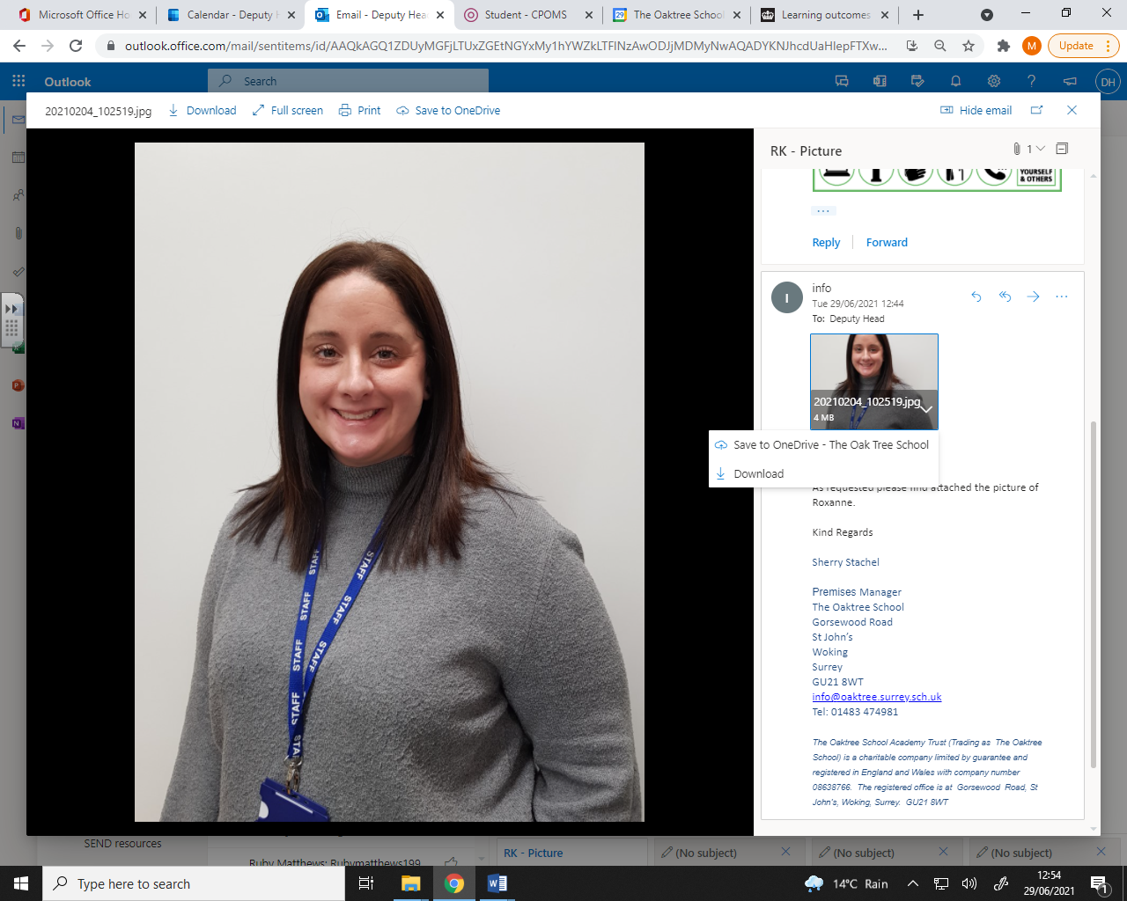
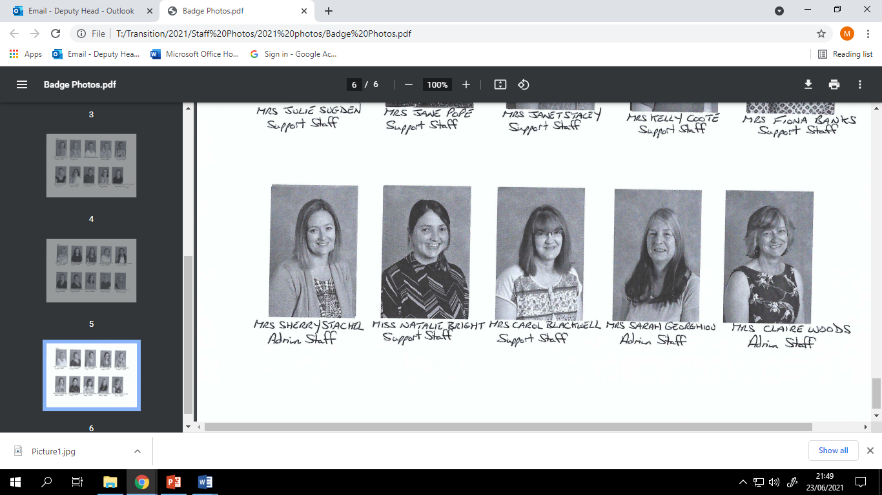
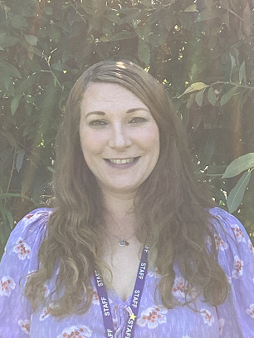
h
Mrs Spires
Executive Headteacher
Mrs Larsen
Deputy Headteacher
The Nursery Team
Mrs Molnar
EYFS Leader
Mrs Knight
Nursery Lead
Miss Bright
Support Staff
Mrs Preston
Support Staff

